Slide 1
My Amazing Triceratops
Design 1 template (use an informative title, lol)
Marguerite Butler

Slide 2
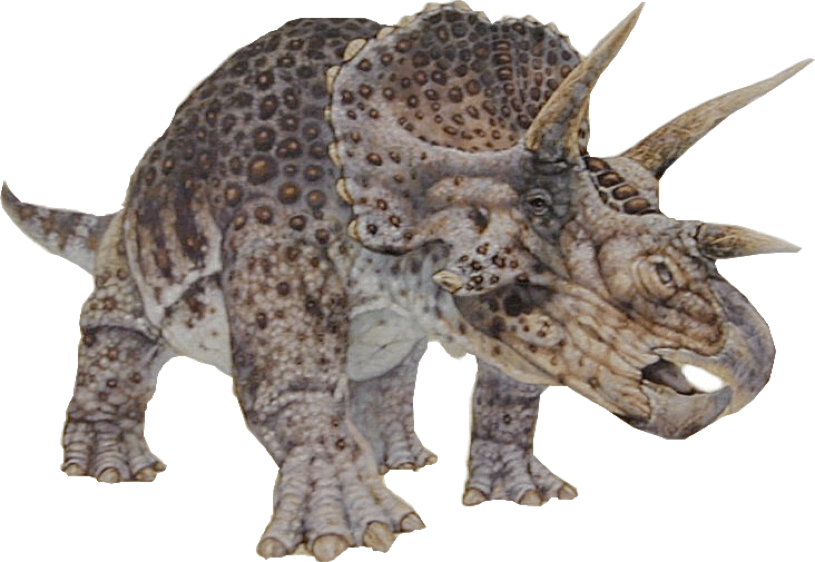
Introduce your animal
Start with what is coolest about your animal
Maybe lead into some physical features - it had the jaw of an herbivore….
At the time of the Jurassic, North America was much warmer
It lived in swamps that was full of food, for example…
It was massive…. BE SURE TO mention its SIZE and Mass

Slide 3
Cover your background info
You have to cover the background related to Metabolic Rate and Heat Balance,
But you can make it more interesting by weaving together the background into a story about how it lived.
For example, I might say "Although it was a huge herbivore, the swamps it lived in had tall cycads and palms offering plenty of shade…. " and show pictures of swamp with shade.
It lived with X, Y, Z, animals but it was one of the biggest animals around so didnʻt have much need to run, except when it fought off a T. Rex (hinting at low activity, but might have to fight)
Donʻt put a lot of text on your slides. Just bullet points and images.
<- these are suggestions for a story to go over the bullet points. But I made it all up, so make up your own story with your facts :)

Slide 4
End intro with your question or statement of purpose

Slide 5
Mass and Standard Metabolic Rate
Did you have to model the volume to get the mass? Show us your major assumptions and what geometry did you use? State the strategy and the final number. If it is from a published estimate, you can just say that.
How did you model SMR? Tell us and show us the scaling equation and assumptions (mass, Tb, etc.). Did you assume SMR or RMR at rest? Give us the final number.

Slide 6
Heat Balance at Rest
A good strategy is to go through the heat balance at rest, and then you can just state for your other scenarios what is happening and what you assumed (what changed relative to rest)
At rest, we envisioned the triceratops was … (tell us what is going on)
Be explicit about your critical assumptions
Did you model it as an endotherm or ectotherm? Why?
Go through each component, tell us the critical assumptions, and the evidence or reasoning for those choices, and any essential equations (you can just say or show the equation and then move on). Give the result for each (donʻt have to show calculations for a talk).
At the end, show us the delta Hs and the change in Tb to demonstrate heat balance.

Slide 7
Fighting the T Rex
The major stressor for Triceratops may have been fighting off a T Rex. They were both diurnal, …
It would have spiked in metabolic rate by … we assumed ….
Go through all of the changes relative to rest.
Be sure to end with the Heat balance:
Delta Hs = Hm +/- Hc +/- He +/ Hr
+170 kJ/hr = 240 kJ/hr - 150 kJ/hr - 120 kJ/r + 200 kJ/hr
Delta Tb = …. Is its body temperature actually increasing?

Slide 8
Daily Metabolic Rate and Heat Balance
A typical day in the life of Triceratops might have been ….
Go through the DMR (both activity levels and time for each).
Be sure to end with the Heat balance:
Delta Hs = Hm +/- Hc +/- He +/ Hr
+170 kJ/hr = 240 kJ/hr - 150 kJ/hr - 120 kJ/r + 200 kJ/hr
Delta Tb = …. Is its body temperature actually increasing?

Slide 9
Conclusions
Was it way out of heat balance? Why – what where the major contributors?
Maybe it was fine at rest, but heat stress caused a big temperature increase. How could it have gotten back into heat balance?
What about your hypothesis for DMR? Was that easy to balance in terms of heat? What does that suggest?
Did you learn something about your animal? Would it apply to other animals? What kinds? How broadly could it apply?

